Slide 1
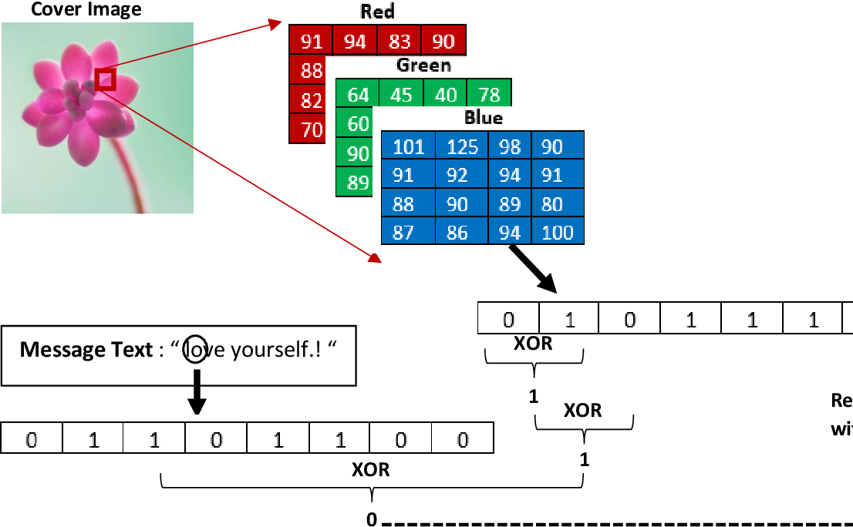

hiding data inside images using Least Significant Bit (LSB) algorithm
Doc:Ahmed Mostafa Elmahlawy Amira Mohamed Menshawy

Slide 2
First of all, what is it LSB ?
Least Significant Bit (LSB) is considered one of the simplest and most widely used algorithms for Data Hiding. It is primarily used to hide data within digital media such as images, audio, or video.
Why is LSB a Data Hiding Algorithm?
Hiding in the Least Significant Bit:
The LSB algorithm replaces the least significant bits of pixel values in images, or audio samples, with the bits of the data to be hidden.
These changes are usually imperceptible to the human eye or ear, making it effective for hiding data.
Simplicity and Ease of Implementation:
LSB is easy to implement and does not require complex mathematical operations.
It is commonly used in educational projects and applications that do not require high-security levels.

Slide 3
First of all, what is it LSB ?
How Does It Work for Data Hiding?
In Images: The least significant bit of each pixel (or multiple bits, depending on the image's capacity) is replaced with the bits of the hidden data.
In Audio: Audio samples are modified by replacing the least significant bits with bits of the data to be hidden.
In Videos: Data is hidden across video frames in a similar way as in images.

Slide 4
First of all, what is it LSB ?
Advantages of LSB:
Fast and Easy to Implement:
It is computationally simple and quick to execute.
Minimal Quality Impact:
It does not cause noticeable changes in media quality when hiding small amounts of data.
Versatility:
Works well with low-sensitivity images and audio files.
Limitations of LSB:
Easily Detectable:
Hidden data can be detected using steganalysis techniques.
Lacks Security:
It does not provide encryption or security for the hidden data.
Vulnerable to Compression or Alteration:
If the image or audio undergoes compression (e.g., JPEG), the hidden data may be lost.
Can LSB Be Improved?
Yes, LSB can be enhanced by:
Encryption: Encrypting the data before hiding it to improve security.
Advanced Techniques: Using more robust algorithms such as DCT (Discrete Cosine Transform) or DWT (Discrete Wavelet Transform), which operate in the frequency domain instead of the spatial domain.

Slide 5

The project will allow:
Input image (steganographic media).
Input text (hidden data).
Hide text inside image.
Extract text from image.
Image
Text
I'm not just a cat I'm a data hacker

Slide 6
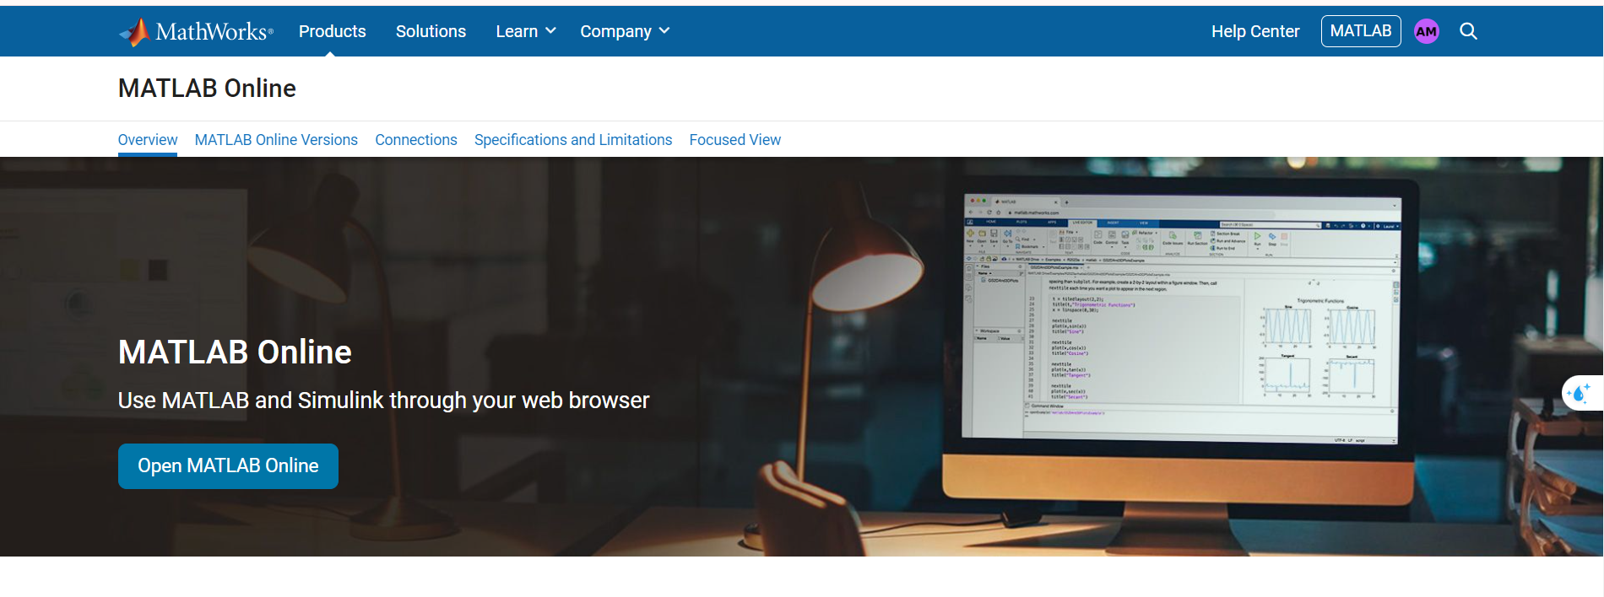
Let's use the online version of MATLAB.

Slide 7
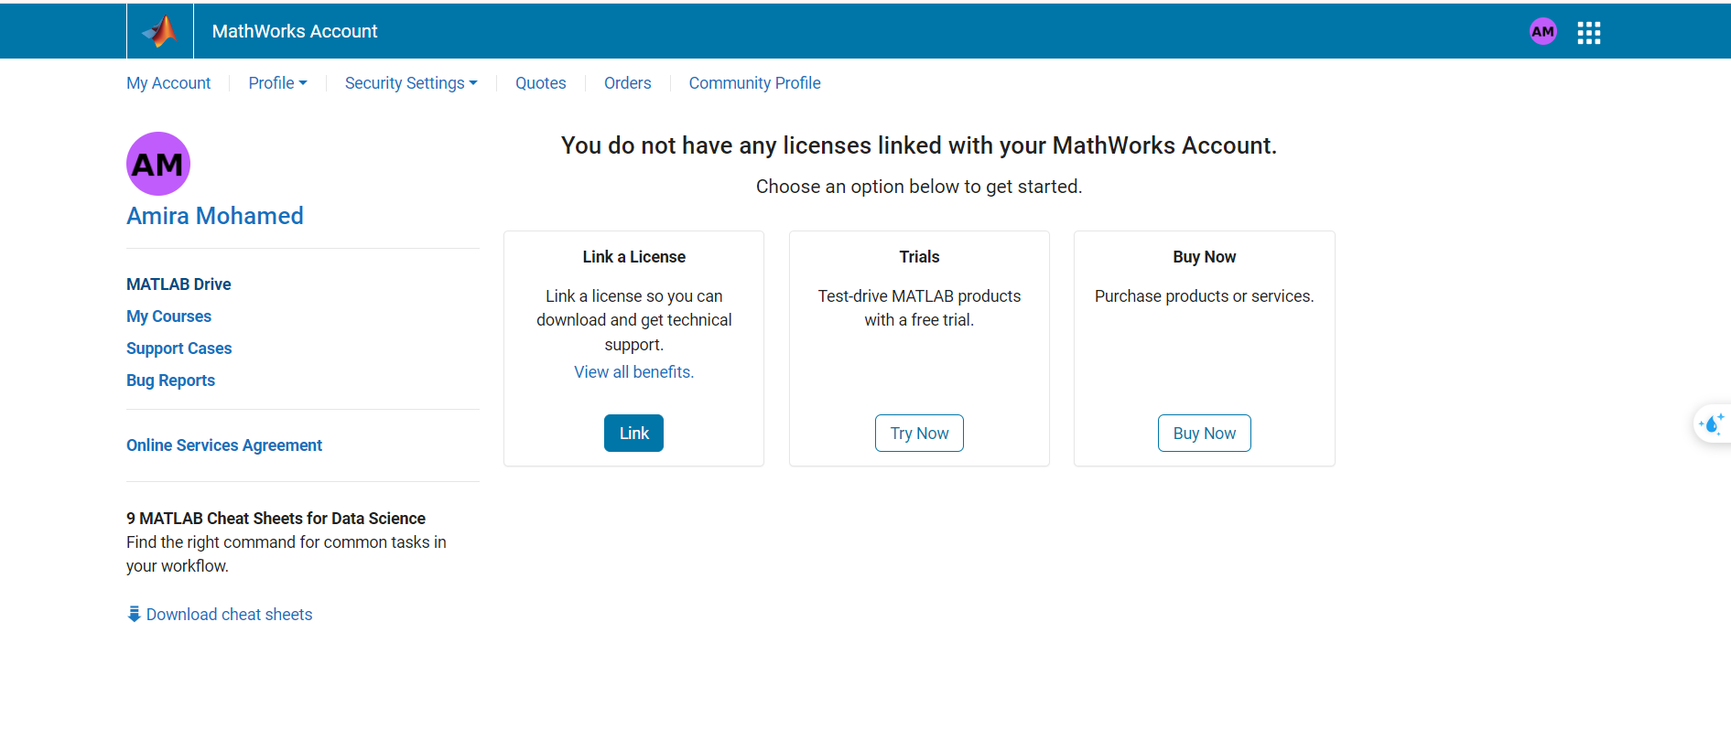
First, we need to upload the image in which we will hide the data to the MATLAB drive.

Slide 8
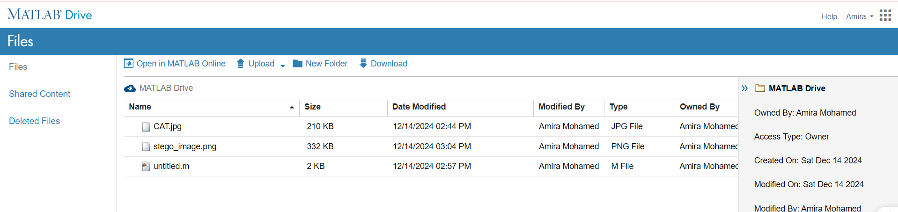

Slide 9
Writing the Code: write the script for the LSB data hiding algorithm:
Load an Image:
% Load Image
[file, path] = uigetfile({'*.png;*.jpg;*.bmp'}, 'Select Cover Image');
cover_image = imread(fullfile(path, file));
cover_image = cover_image(:, :, 1); % Grayscale Image
figure, imshow(cover_image), title('Original Image');
2.Input Text to Hide:
% Input Text
text_to_hide = input('Enter the text to hide: ', 's');
binary_text = reshape(dec2bin(text_to_hide, 8).' - '0', 1, []);
text_length = length(binary_text);
if text_length > numel(cover_image)
error('Text is too large to hide in this image.');
end

Slide 10
3.Embed Text into the Image:
% Hide Text
stego_image = cover_image;
stego_image(1:text_length) = bitset(stego_image(1:text_length), 1, binary_text);
figure, imshow(stego_image), title('Stego Image');
4.Save and Extract Text:
% Save Stego Image
imwrite(stego_image, 'stego_image.png');
disp('Stego image saved as "stego_image.png".');
% Extract Hidden Text
extracted_bits = bitget(stego_image(1:text_length), 1);
extracted_text = char(bin2dec(reshape(char(extracted_bits + '0'), 8, []).')).';
disp(['Extracted Text: ', extracted_text]);

Slide 11
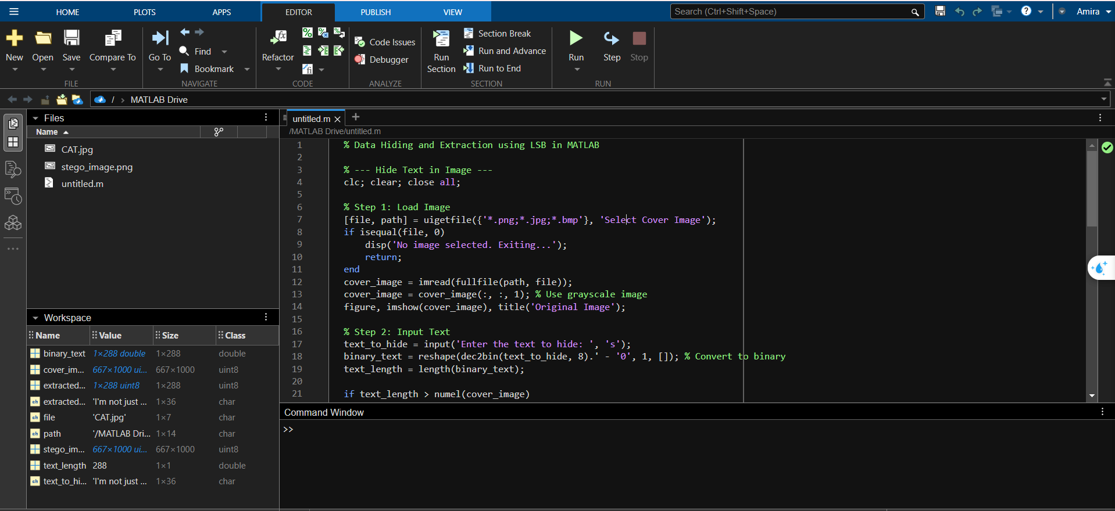
You can see the source code on this site.
Write the code on matlab
https://www.mycompiler.io/view/B7Hm8ovG8Vj

Slide 12
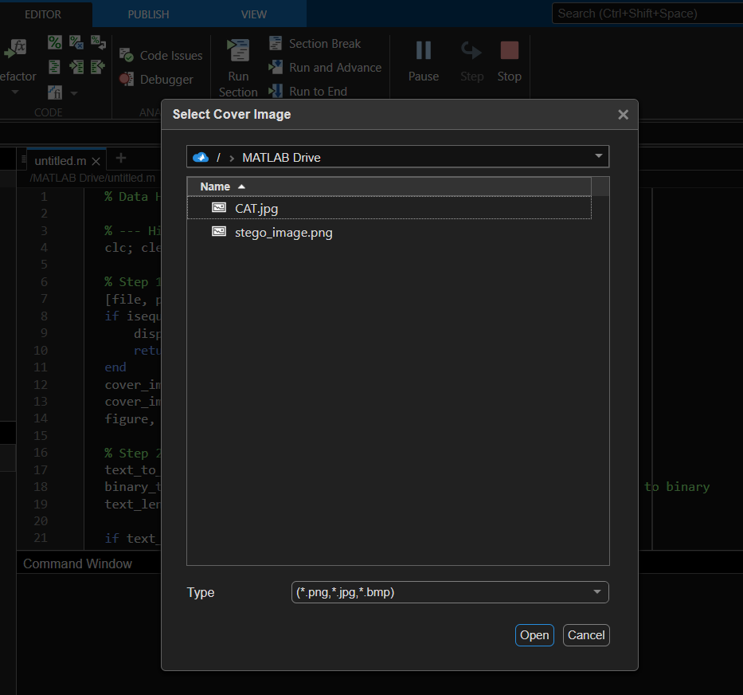
When you run the Program, you will be asked to enter the photo.

Slide 13
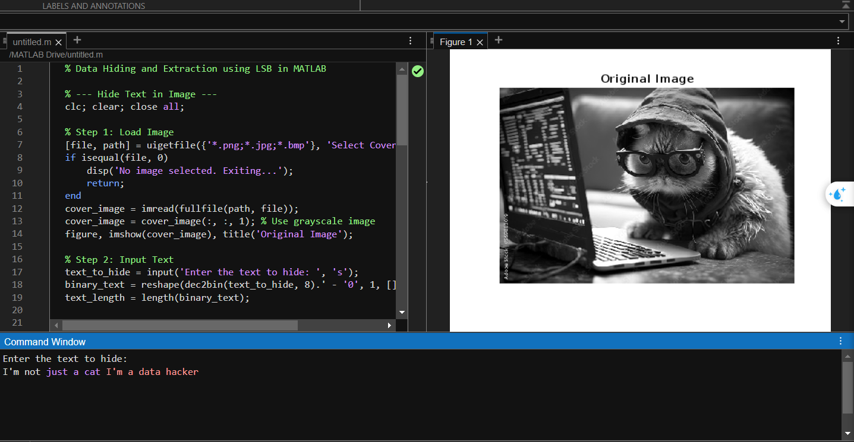
The original image has been uploaded successfully with the text to be hidden inside the image.

Slide 14
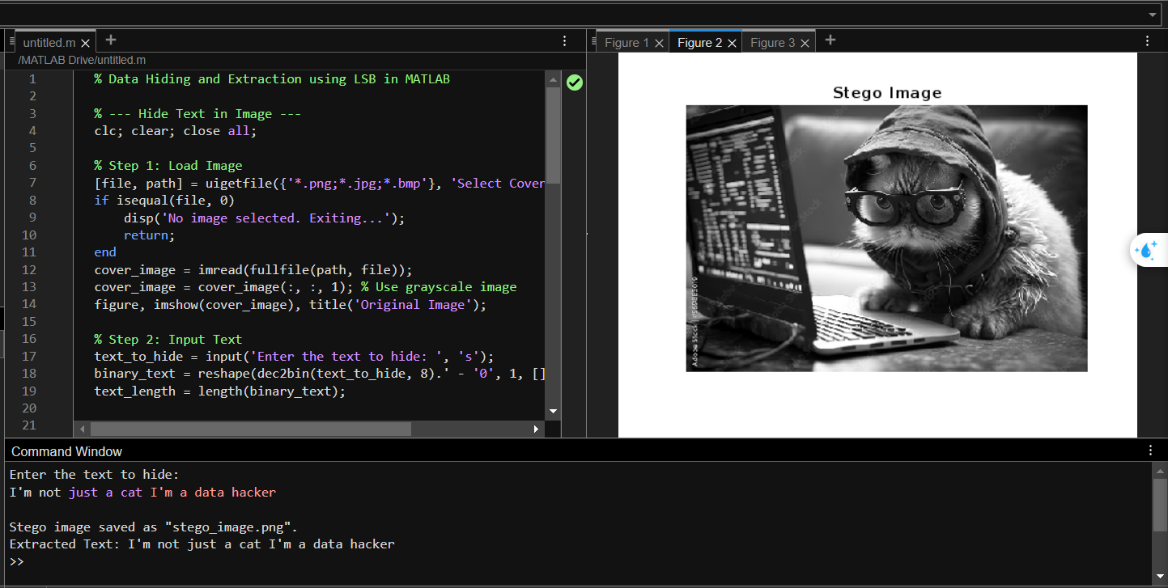
The text is hidden inside the image to became Stedo Image.

Slide 15
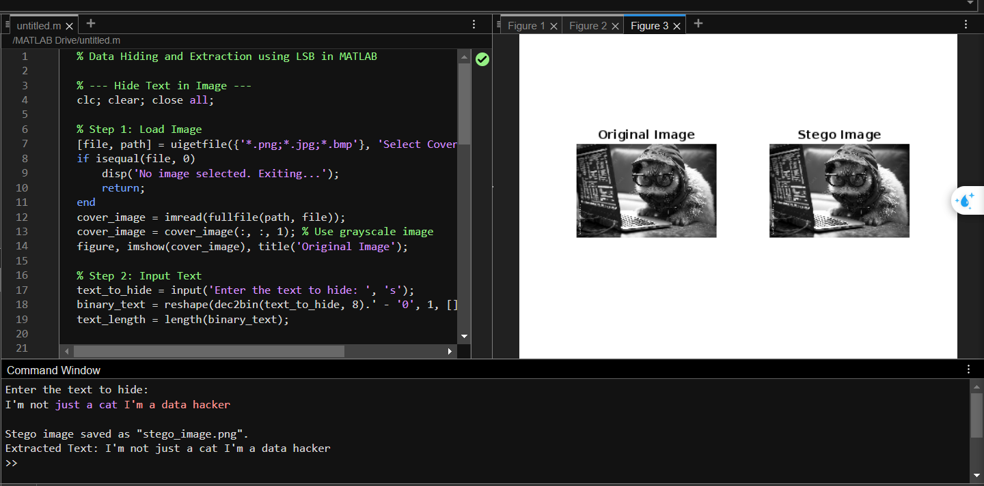

Slide 16
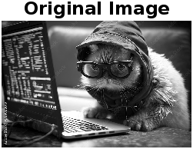
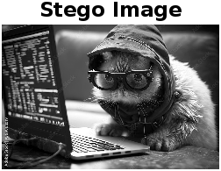
We notice that it is a successful process because we do not destroy the original image and the text does not appear clearly on the stego image.

Slide 17
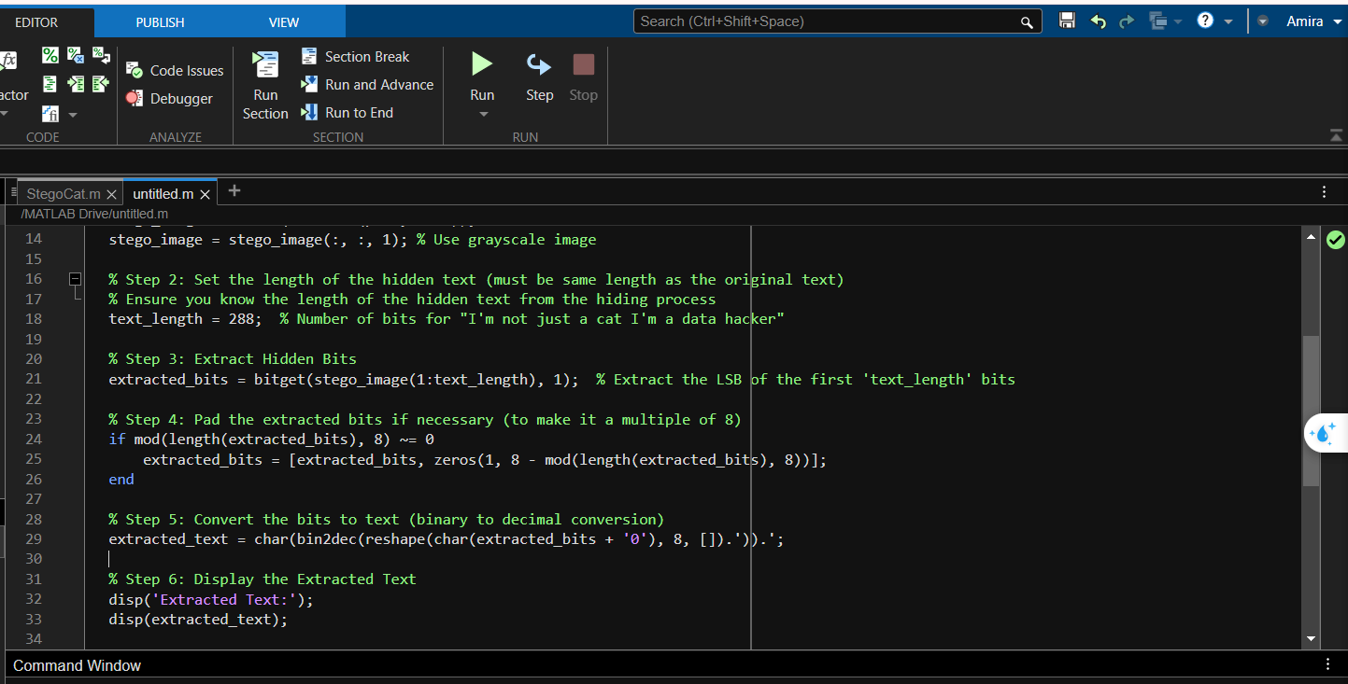
extract text from Stego image (reverse process)
You can see the source code on this site.
https://www.mycompiler.io/view/J1eD06JlLsH

Slide 18
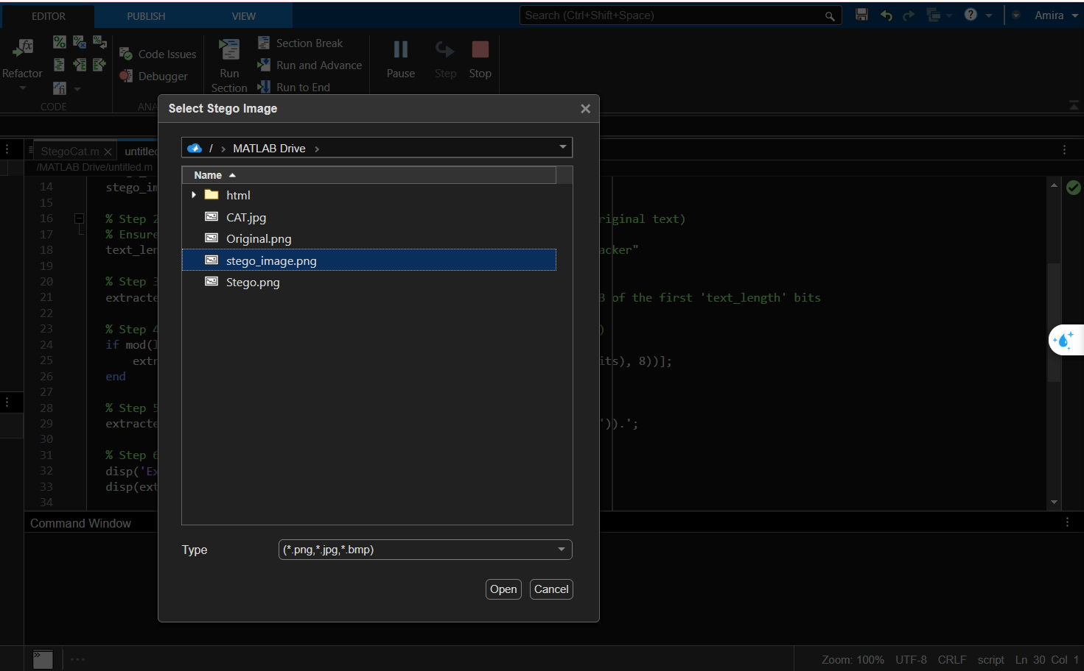
Upload the Stego image

Slide 19
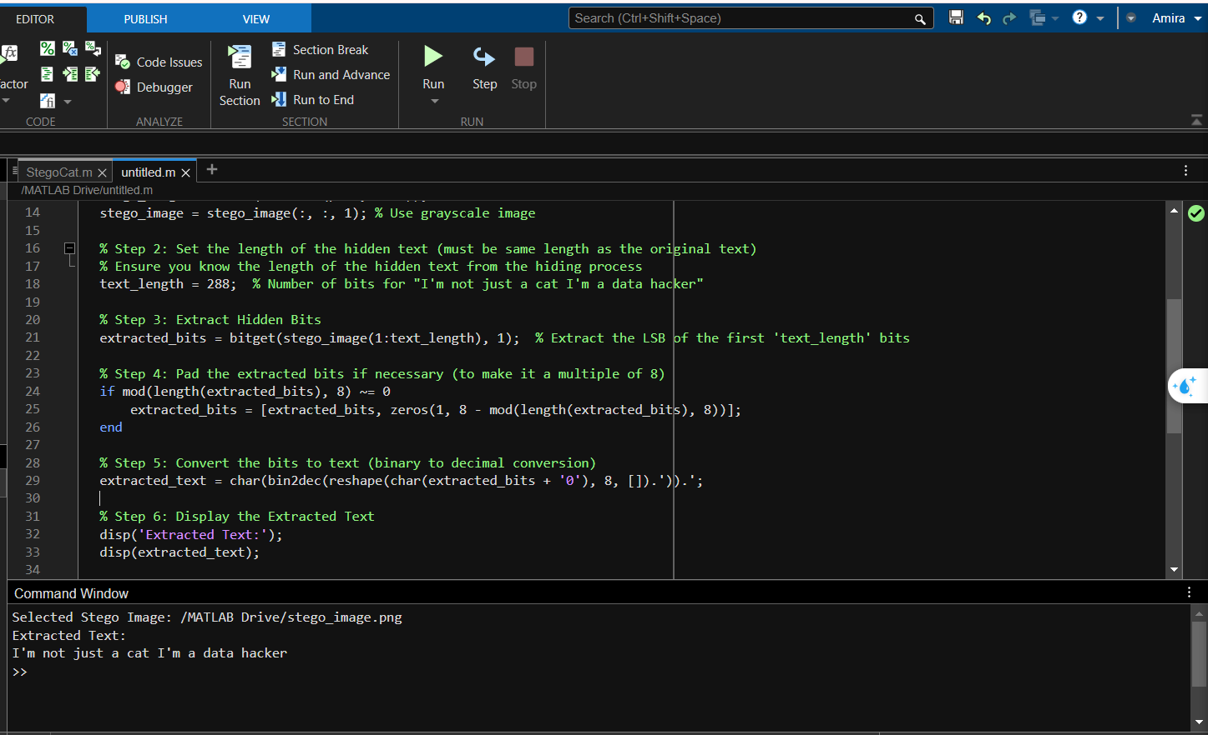

We got the text that was hidden.

Slide 20


